Slide 1
Data Wrangling
Assignment 2
By Ambrish Krishna Muralitharan(S10223486G)

Slide 2
Table of Contents
1. Problem Evaluation
1.1 Problem Statement
2. Jupyter Notebook
2.1 Load Data
2.2 Data Wrangling Techniques
2.3 Data Cleansing and Transformation Techniques
2.4 Machine Learning Model
2.5 Predictions
3. Summary
3.1 Conclusion
3.2 Further Improvements

Slide 3
01
Problem Evaluation

Slide 4
1.1 Problem Statement
“To predict the the positions of the drivers for each race using a Linear Regression model”

Slide 5
02
Jupyter Notebook

Slide 6
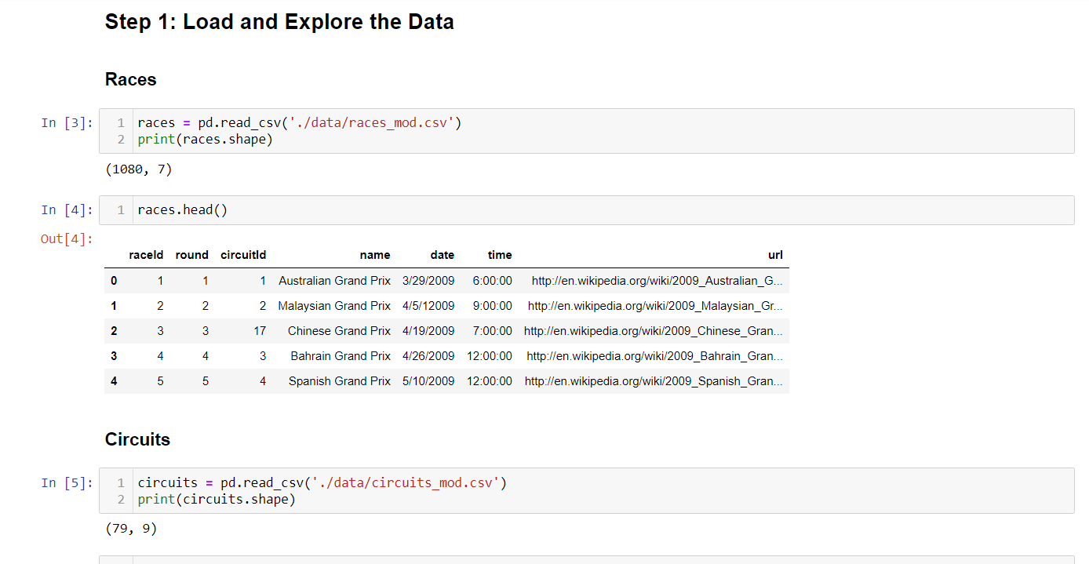
2.1 Load Data
First step to do in Jupyter Notebook
Load all the data such as races.csv, drivers.csv, seasons.csv, etc.

Slide 7
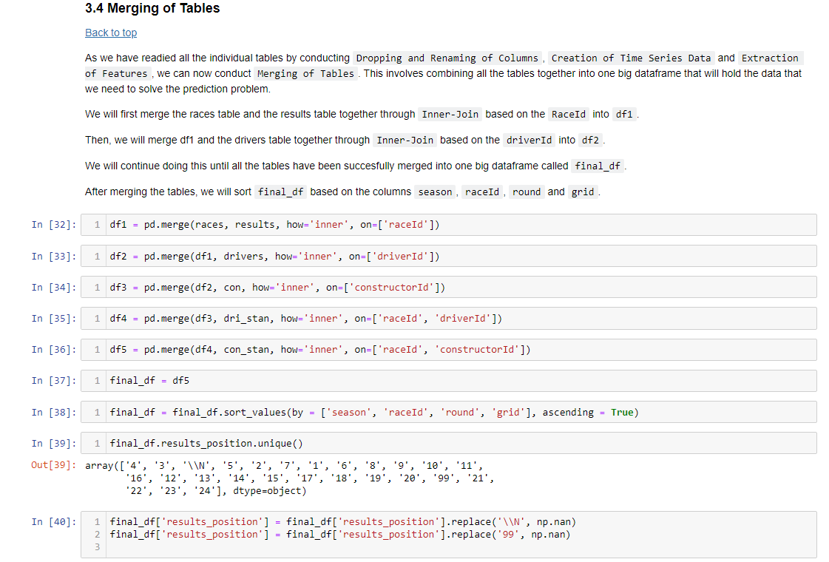
2.2 Data Wrangling Techniques
Dropping and Renaming of Data
Creation of Time Series Data
Extraction of Features
Merging of Tables
Filtering of Tables

Slide 8
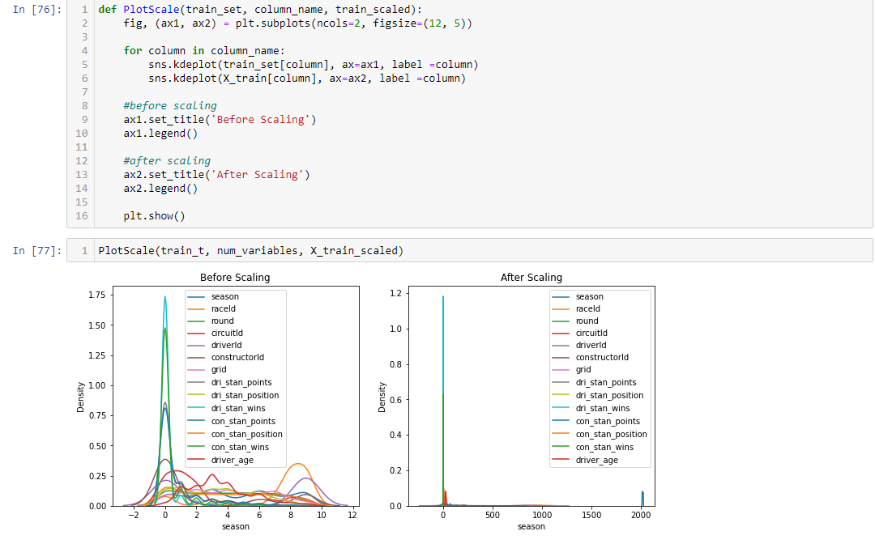
2.3 Data Cleansing and Transformation Techniques
Missing Values and Outliers
Train and Test Split
Numerical Data Transformation
Categorical Data Encoding
Variable Discretization
Feature Scaling

Slide 9
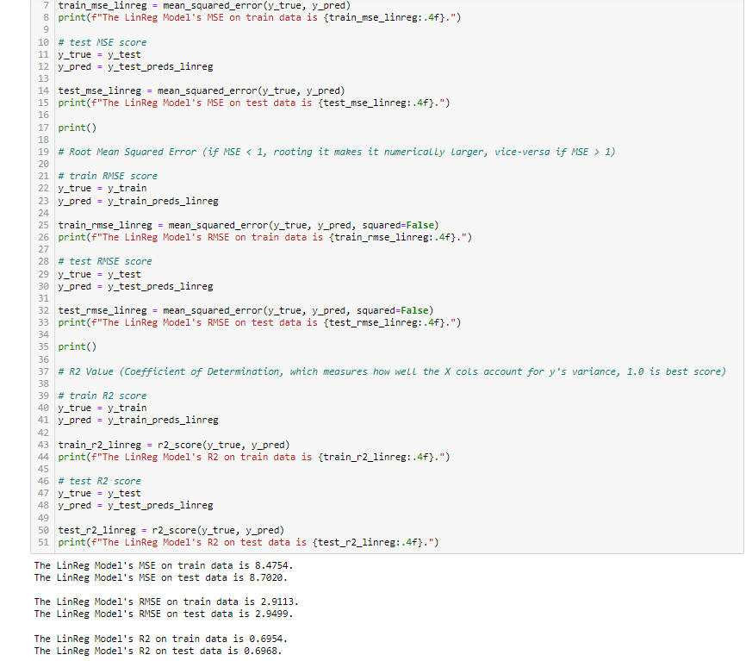
2.4 Machine Learning Model
Count of Rows and Columns
Naïve Baseline Model
Linear Regression Model

Slide 10
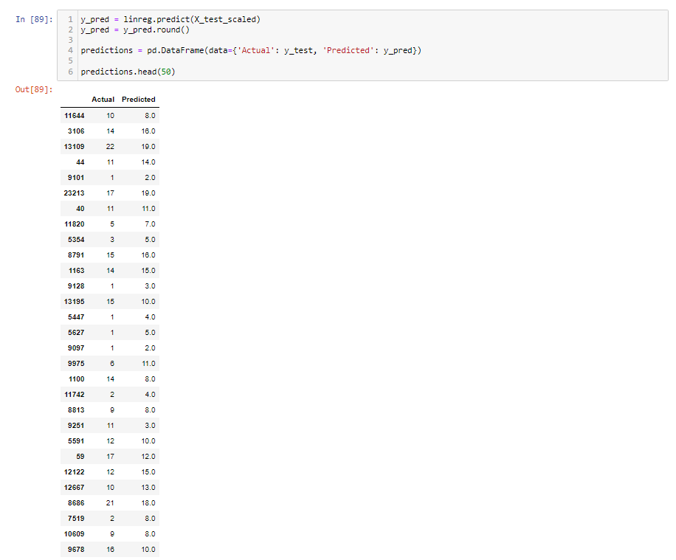
2.5 Predictions
New dataframe called Predictions created with 2 columns
2 columns : Actual Positions vs Predicted Positions
Predicted values are very close to actual values achieved

Slide 11
03
Summary

Slide 12
3.1 Conclusion
Test MSE, RMSE & R2 higher than Train MSE, RMSE & R2
Likely to be caused by Overfitting
Linear Regression Model metrics performed better than Naïve Baseline Model
Good fit and Performance for Linear Regression Model
Predicted Values very close to Actual Values

Slide 13
3.2 Improvements
Mathematical Computations for Feature Scaling
Overfitting
Need to make use of Math Computations for feature scaling as it can improve performance of model
Need to ensure that none of the test and train sets are overfitted as it can cause for poorer performance

